Slide 1
Information Search Skills and Digital Resources
Vijayakumar K. P., Ph. D.
Head, Department of Library and Information Science University of Kerala, Thiruvananthapuram – 695 034
kpvijayakumar2@gmail.com

Slide 2
Information Search Skills
There are a number of different components to search skills:
1. Knowing where to find information - the key texts in your area, the journals, primary sources, etc., and how to get hold of them.
2. Knowing what information you need - understanding your topic and knowing the key concepts you should research.
3. Knowing how to search the sources - using keywords etc.

Slide 3
Dimensions of Information Literacy
With successive developments in ICT, it has become essential to acquire various skills to access the right information.
They are:
Computer literacy
Digital literacy
IT literacy

Slide 4
Dimensions of IL…
Internet literacy
Library literacy
Media literacy
Network literacy
Visual literacy etc.

Slide 5
Finding information sources
Formal ways
University libraries
Special libraries and government departments
Inter-library loan
Informal ways
Authors
Personal libraries of experts
Your friends

Slide 6
Bibliographic aids
Library catalog
Indexing journal
Abstracting journal
Bibliography
Bibliographic database
People
Experts
Librarians

Slide 7
Digital sources of information
Abstracting and indexing services
Other bibliographic services
-- OPACs
-- Citation indexes
-- TOCs
Numerical collections and textbases
E-journals
E-books
Multimedia products
News services

Slide 8
Start searching

Slide 9
Start searching

Slide 10
Author/title searches
Searching by author and/or title obviously assumes that you are searching for a particular author or book or article title.
Obviously particular search engines will vary, but there are some general guidelines:
When searching by author, put the author’s last name first i.e. Kotler, Philip, not Philip Kotler
When searching by title, it helps if you enter the title as correctly as possible.
If searching for an organization, give the full name of the organization as it commonly appears, e.g. World Bank

Slide 11
Snowball search
This is a good way of searching if your topic has a key work or author.
Look in that work for the key people on whom that author draws, making a preliminary bibliography from that.
Do the same for each of the subsequent authors.
If your key work is a few years old, then you can follow the stream of research up to the near present and trace citations of that author using a specialized citations database, such as the Social Science Citation Index.
That way, you can see the way in which the work/author has influenced subsequent work.

Slide 12
Keyword searches
Keywords are a way of searching through subject/topic.
Most library catalogues and databases will include an option to search by keyword and an alternative to author and title.
Searching by keyword can be very effective, provided you select terms that accurately describe what you are looking for.
Authors often pick out their own keywords to describe an article, which means that they come up more easily in a search.

Slide 13
Keyword searches…
In order to make your search as wide as possible, you need to ensure that you include:
Variations of the same word
American vs. English spelling; Singular and plural; Abbreviations/acronyms,
e.g. TQM/Total Quality Management
Different words with same meaning
Corporate sponsorship, corporate giving
Marketing evaluation, marketing measurement
Entertainments industry, leisure industry
Some search tools understand natural language, and automatically try and find as many of your words as possible.

Slide 14
Other Search Techniques
Boolean Operators
Phrase Searching
Truncation / Wildcard Searching
Proximity Searching
Focusing / Limiting a Search

Slide 15
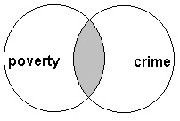
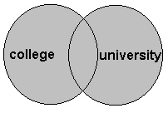
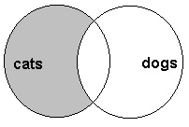
Boolean Operators
Boolean operators allow you to join terms together, widen a search or exclude terms from your search results. This means you can be more precise in locating your information.
AND
OR
NOT

Slide 16
Boolean Search
You can use Boolean search strings to carry out a very specific search: for example, you might want to find out about job appraisal in the catering industry. Both ‘job appraisal’ and ‘catering industry’ are terms that can be variously expressed, so you might want to phrase your search thus:
Job OR performance appraisal AND catering OR hospitality OR leisure industry
You could, however, put brackets round concepts or phrases you want to link to ensure that these terms are searched first, thereby giving a structure to your search:
(Job OR performance appraisal) AND (catering OR hospitality OR leisure industry)

Slide 17
Boolean Operators at Emerald

Slide 18
Phrase Searching
It narrows your search down by searching for an exact phrase or sentence. It is particularly useful when searching for a title or a quotation. Usually quotation marks are used to connect the words together.
For example,
“Towards a healthier Scotland”

Slide 19
Truncation / Wildcard
These search techniques retrieve information on similar words by replacing part of the word with a symbol usually a * or ?
However, different databases use different symbols, so check what is used.
In truncation the end of the word is replaced.
For example physiother* will retrieve physiotherapy, physiotherapeutic, physiotherapist and so on.
In wildcard searching, letters from inside the word are replaced.
For example wom*n will retrieve the terms woman and women.

Slide 20
Proximity Searching
It looks for documents where two or more separately matching term occurrences are within a specified distance, where distance is the number of intermediate words or characters.
For example
Term A NEAR Term B
Term A ADJ Term B

Slide 21
Focusing / Limiting a Search
There are many ways to focus your search and all search tools offer different ways of doing this. Some of the ways of limiting your search are as follows:
Date
Language
Place
Publication type
Age groups
Type of material e.g. you could just need to find case studies

Slide 22
Final Points
Two final points about using keyword searches in individual databases, library catalogues and search engines:
Individual databases etc. will have different rules about syntax, operators etc. and it is advisable to look at their help pages for guidance.
Some databases and search engines structure their search mechanisms around Boolean searching, as for example the ‘Advanced search’ option of Google, or that in Emerald’s Fulltext, which allows you to search a phrase (otherwise “ “) or use and/or etc.

Slide 23
Types of Growing Electronic Sources
Electronic books and texts
Electronic journals
Electronic databases
Reference sources such as govt. sites/ law sites etc.

Slide 24
Electronic resources…
Digital archives / libraries in CD-ROM and Internet
Numerical/statistical databases
Image/ audio / video sources

Slide 25
Multimedia resources
Web contains audio/video resources
Streaming audio/video is the current way of web broadcasting to avoid copyright issues.
It is a complex process.
Media player/ Real player etc play the files.
Numerous new players are there.

Slide 26
Electronic Books
Electronic equivalent of books
Read with e-book reader
Audio books on Cassette / CD-ROM
Audio books for education /self development
Digital Braille helps blinds

Slide 27
E-Book Readers
Kindle 3
BeeBook Neo
Barnes and Noble Nook
Kobo
Alex eReader
Pandigital Novel
Sony Reader

Slide 28


Slide 29
Online Journals
These are journals published in electronic format, often available on the Internet.
Provides the content of a periodic publication
E-zine is a periodic publication distributed by email/posted in website on a subject area
Webzine, an e-magazine hosted in Web
Cyber-zine is a magazine available online

Slide 30
Online Journals
Directory of Open Access Journals (DOAJ) http://www.doaj.org/
There are now about 9140 journals in the directory.
Currently 4656 journals are searchable at article level.
More than 1 080 000 articles are included in the DOAJ service.

Slide 31
E-Journal Archives
JSTOR - Archive of Scholarly journals, not a current issue database.
Project Muse - Collaboration between libraries and publishers to access e-resources by John Hopkins University
Science Direct - Current issues of over 2000 scholarly Journals.

Slide 32
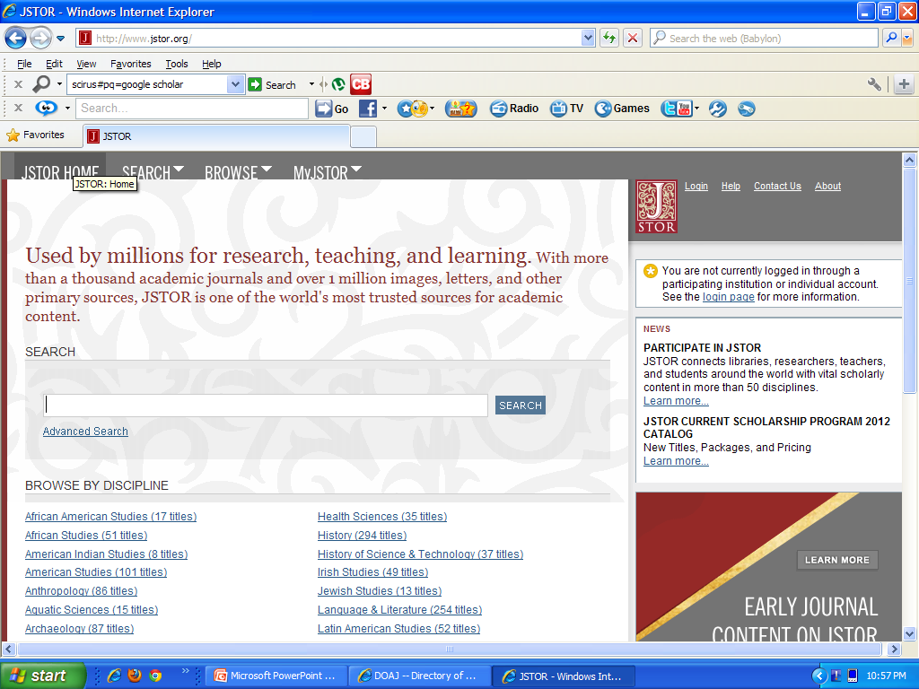

Slide 33
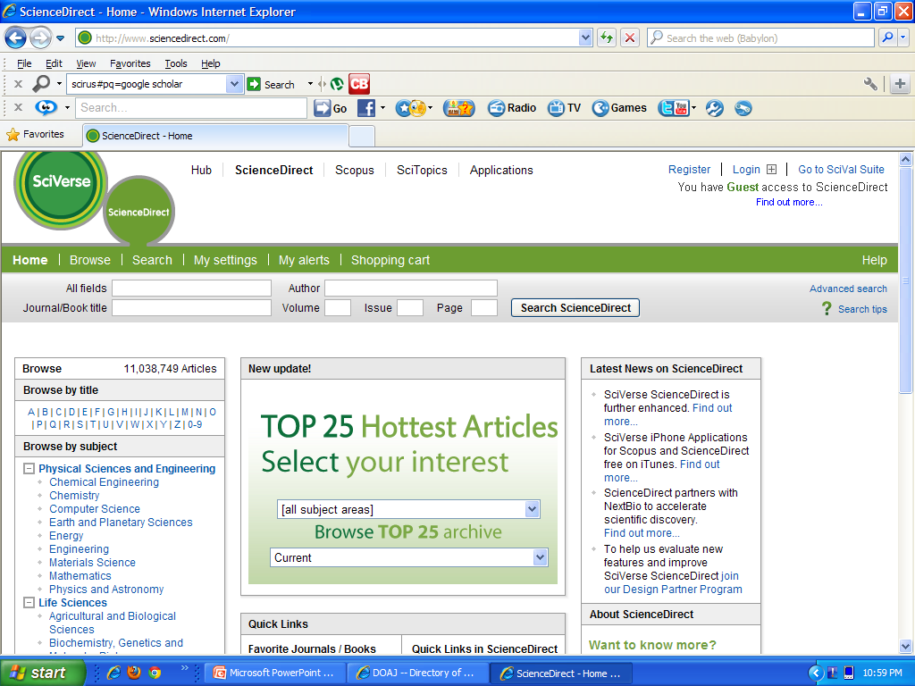

Slide 34
Ebsco
Offers research database, electronic books, journals etc.
Provide access to 100 databases and thousands of e- journals
Serving for 68 years

Slide 35
WikiMedia
Wikipedia : Encyclopedia that allows visitors to write, add or edit documents.
collaborative authoring
It uses Wiki engine.
The name "Wikipedia" is a portmanteau of the words wiki (a technology for creating collaborative websites, from the Hawaiian word wiki, meaning "quick") and encyclopedia.
Wikipedia's articles provide links to guide the user to related pages with additional information.

Slide 36
WikiMedia…
Wiktionary: Collaborative dictionary
Wikibooks: Free text books & manuals
Wikijunior: Children’s books
Wikisource: Collection of texts with free content
Wikiversity: Free learning materials and activities

Slide 37
Wikimedia…
Wikispecies: Taxonomy of plants and animals
Wikiquotes: Collection of quotes
Wikinews: interviews with prominent leaders
Wikimedia Commons: central repository for free photographs, diagrams, maps, videos, animations, music, sounds, spoken texts, and other free media.

Slide 38
Google Scholar
It is collection of citations with links to publishers or other sources.
Google Scholar provides search for scholarly literature.
From one place, you can search across many disciplines and sources: peer-reviewed.
Papers, theses, books, abstracts and articles, from academic publishers, professional societies, universities and other scholarly organizations.

Slide 39
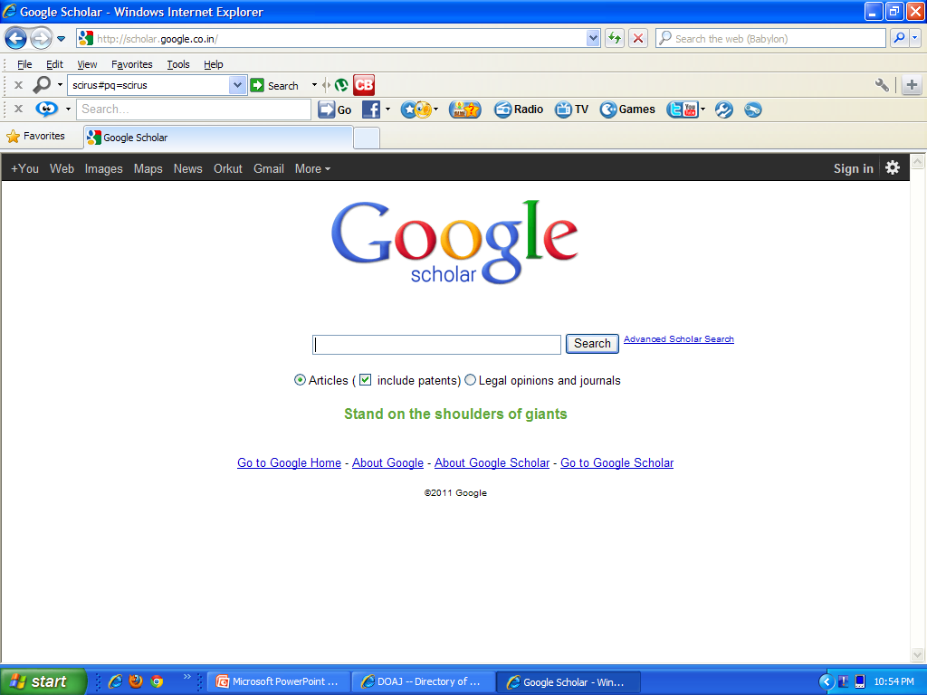

Slide 40
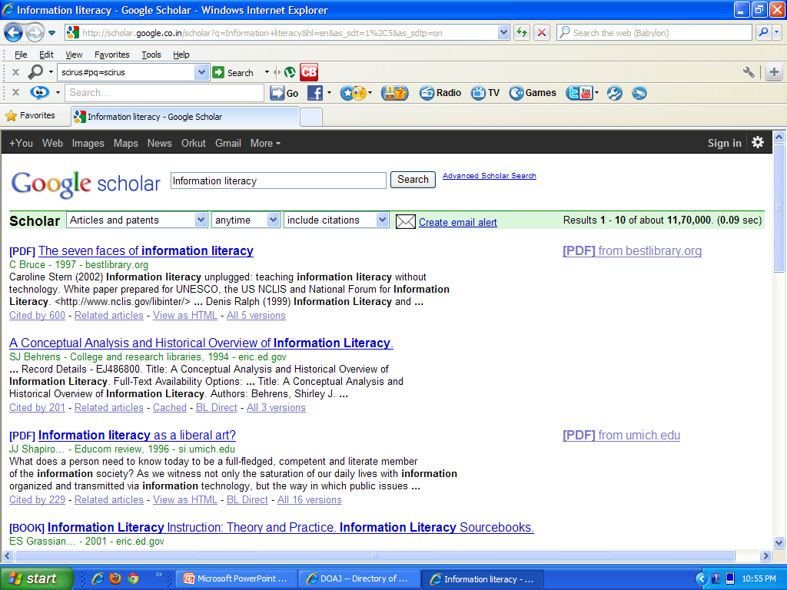

Slide 41
Public Library of Science (PLOS)
It is a nonprofit open access scientific publishing project aimed at creating a library of open access journals and other scientific literature under an open content license.
As of 2006 it publishes PLoS Biology, PLoS Medicine, PLoS Computational Biology. PLoS Genetics, and PLoS ONE (2006).

Slide 42
Scirus
Scirus is a comprehensive science-specific search engine like CiteseerX and Google
Scirus is the most comprehensive scientific research tool on the web.
With over 440 million scientific items indexed, it allows researchers to search for not only journal content but also scientists' homepages, courseware, pre-print server material, patents and institutional repository and website information.

Slide 43
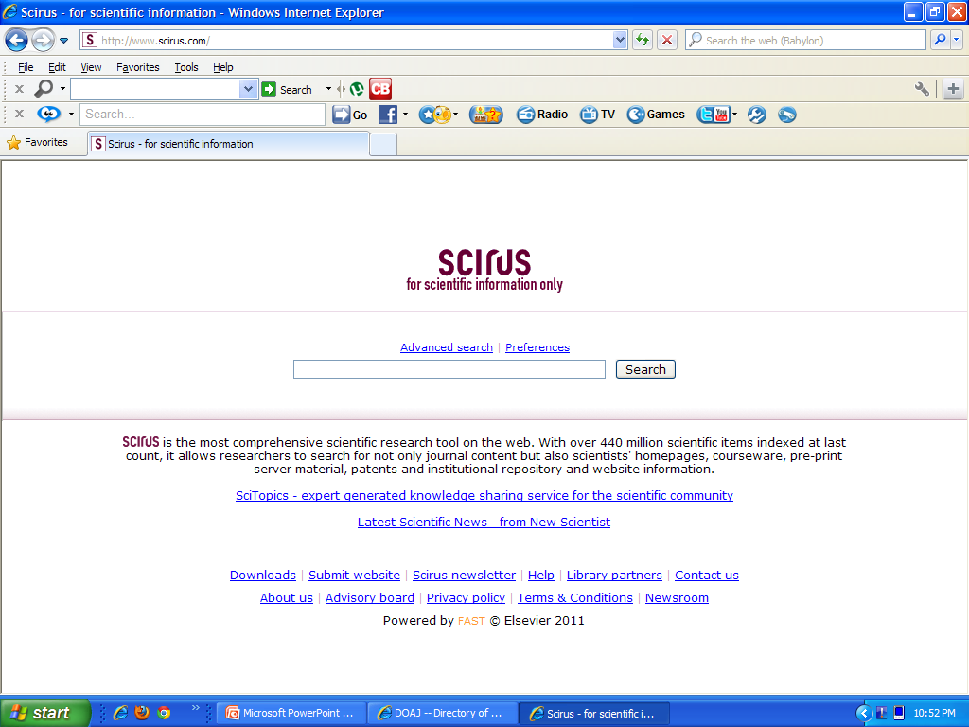

Slide 44
Internet
The Internet is a huge worldwide network of computers connected by various types of communication links.
These linked computers store immense quantity of information about everything under the sun.
The biggest network on the planet always written with the definite article ‘the’.
You can connect your computer also to the Internet for gathering and providing information.

Slide 45
Web contains
Search Engines
Dictionaries
News Papers
Encyclopaedias
E-books
Book Selling site
E- journals
E Theses
Electronic databases – free and paid
Distinct sites - Govt sites/ law sites etc‏
Digital archives /digital libraries
Statistical Databases
Image/ Audio /Video access sites

Slide 46
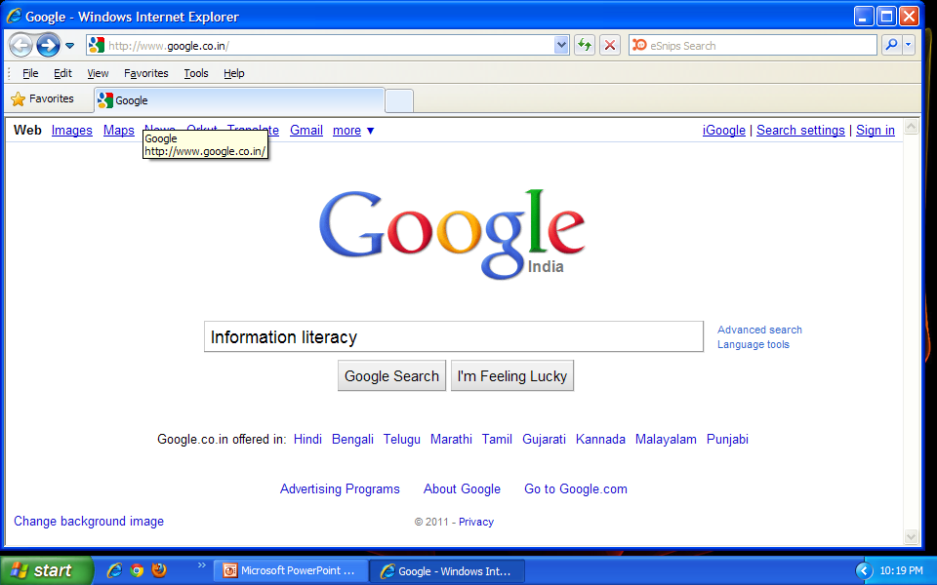

Slide 47
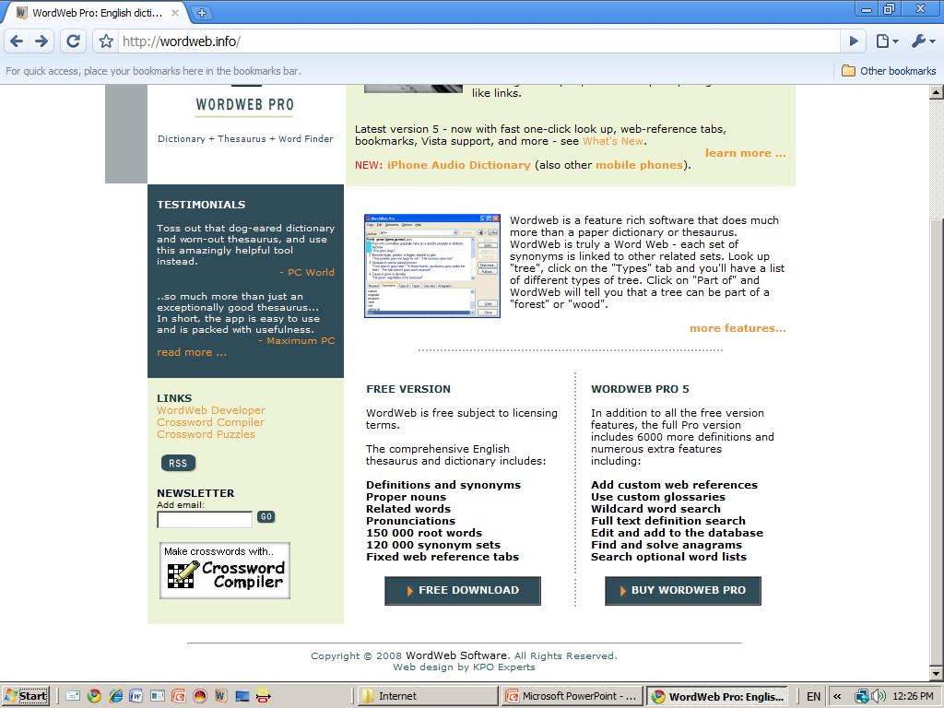
Word Web – Free Dictionary

Slide 48
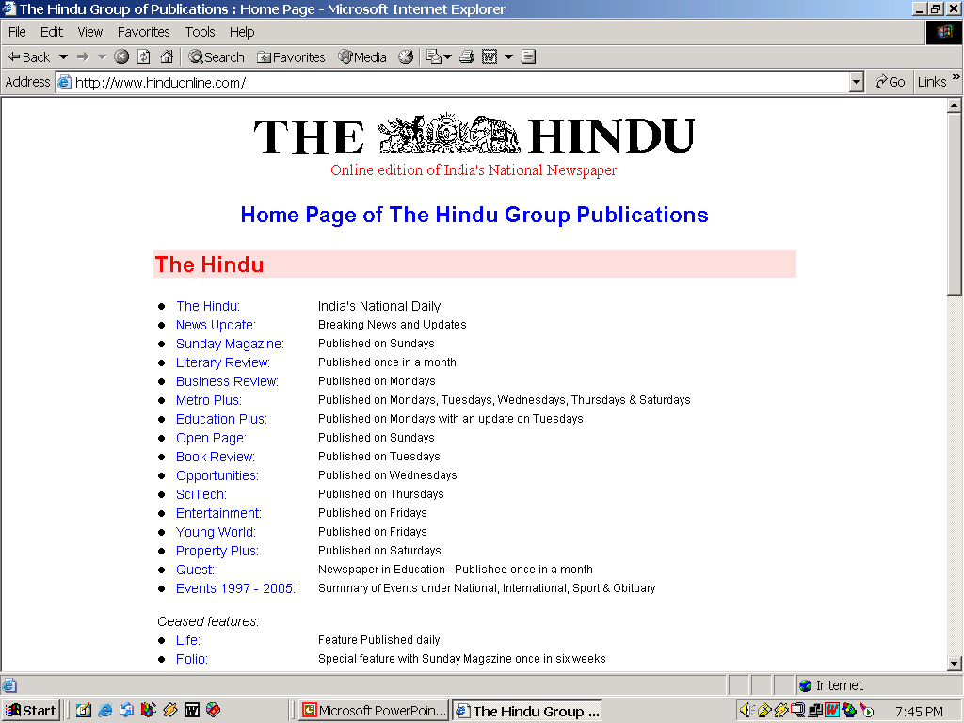

Slide 49
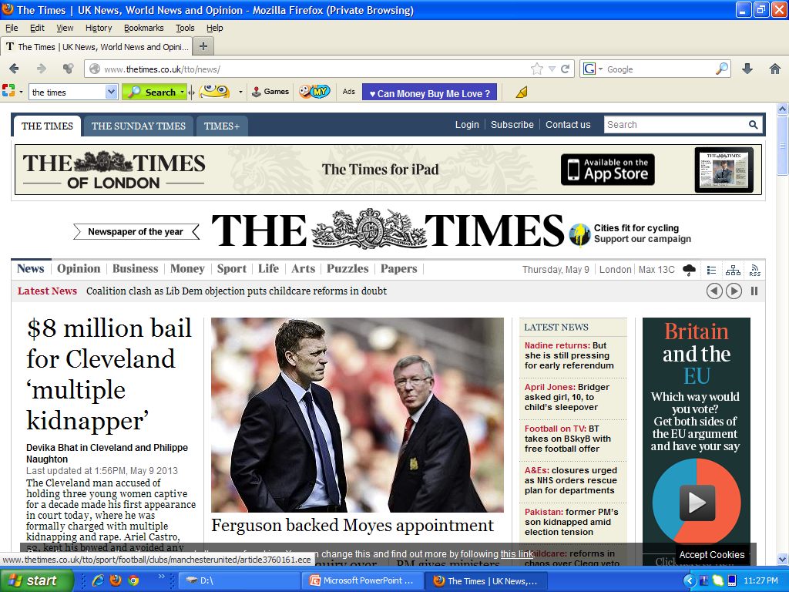

Slide 50
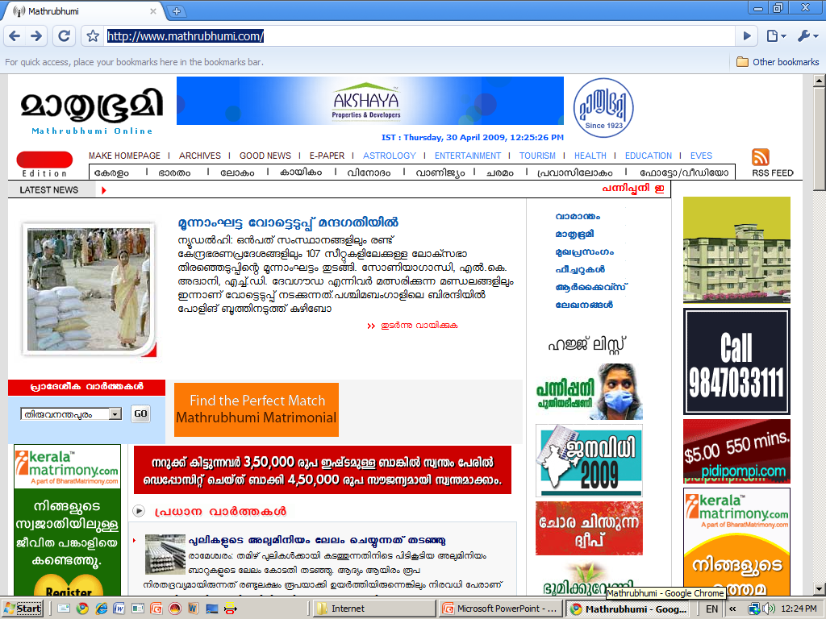
Mathrubhumi

Slide 51
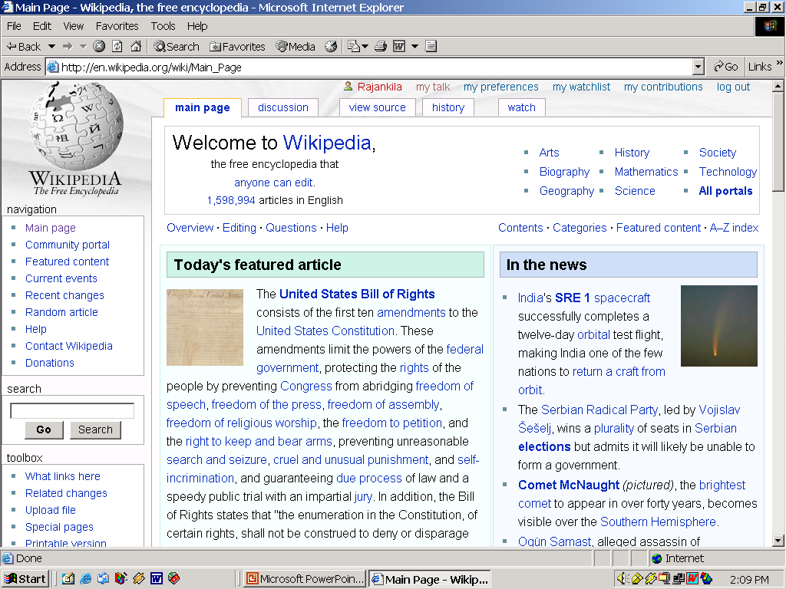

Slide 52
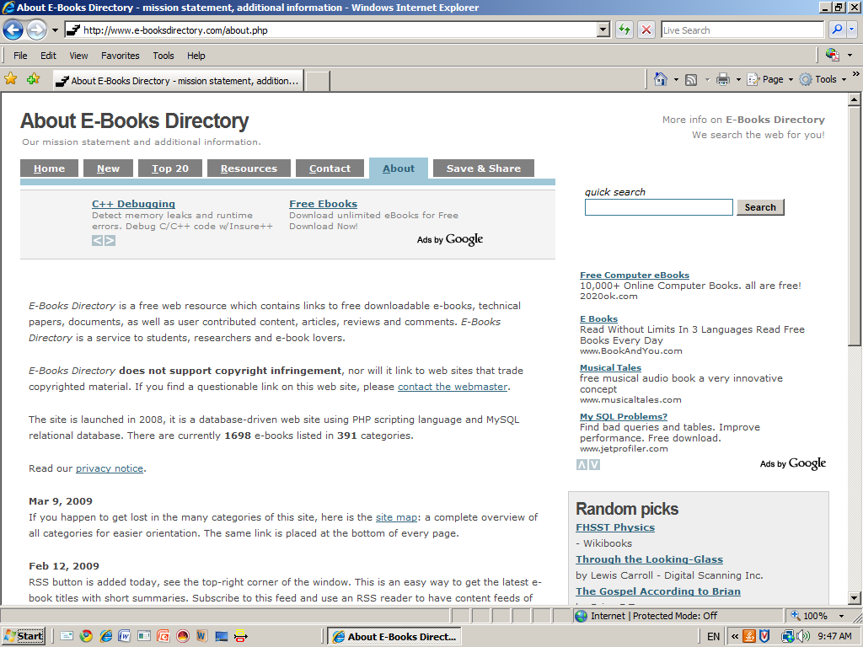
E Book Directory

Slide 53
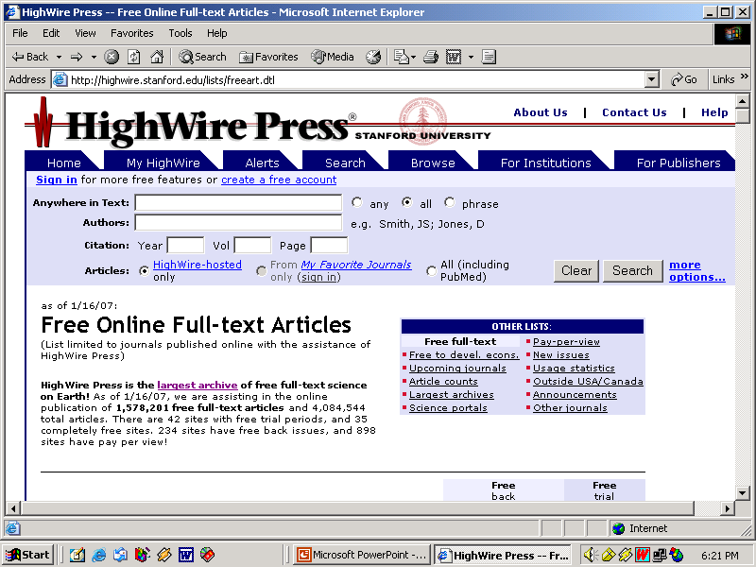

Slide 54
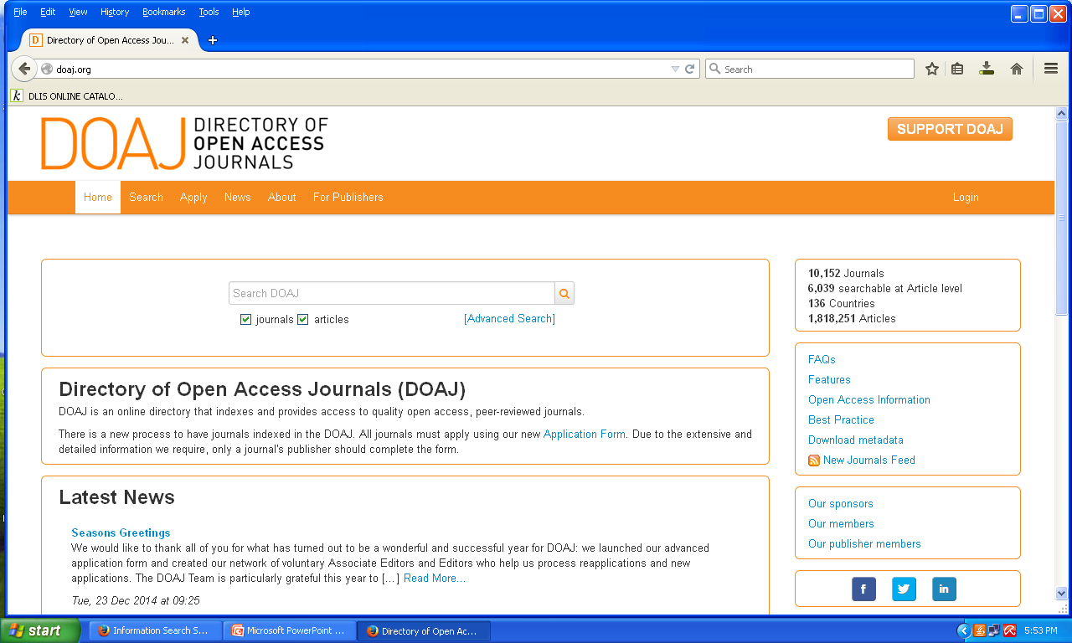

Slide 55
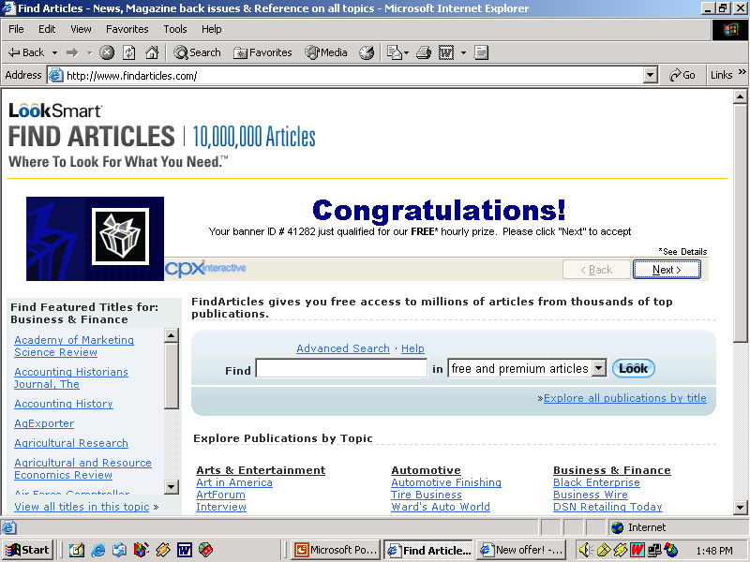

Slide 56
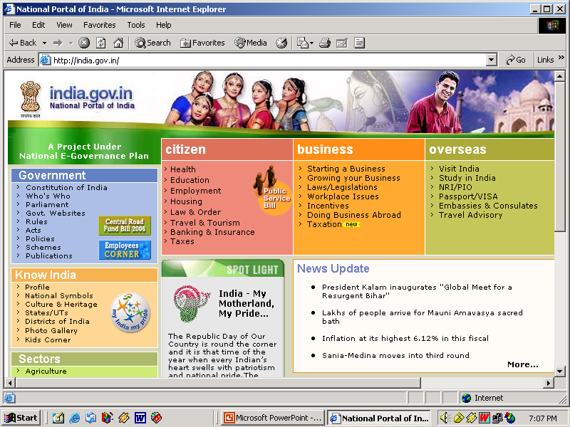

Slide 57
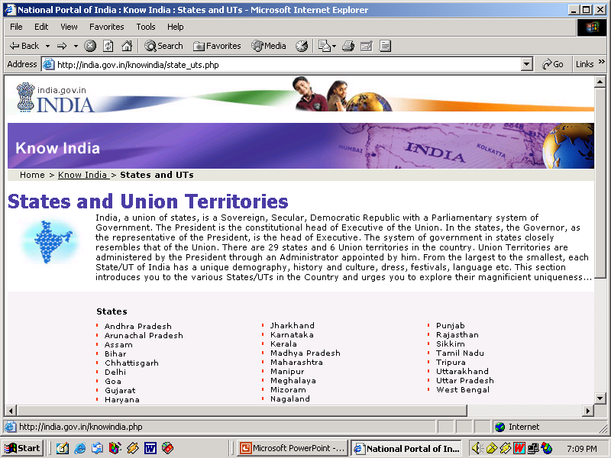

Slide 58
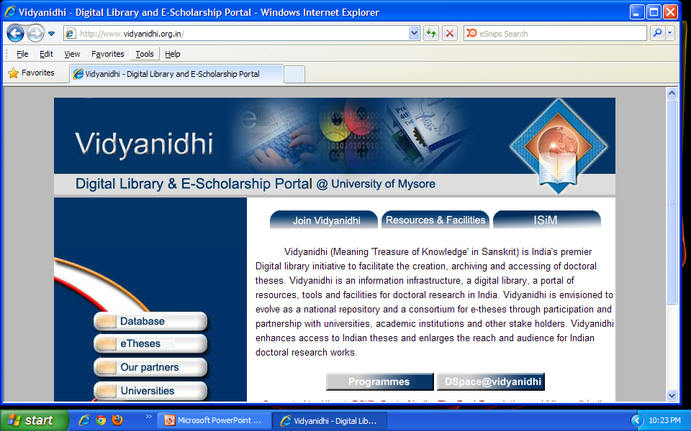
Vidyanidhi

Slide 59
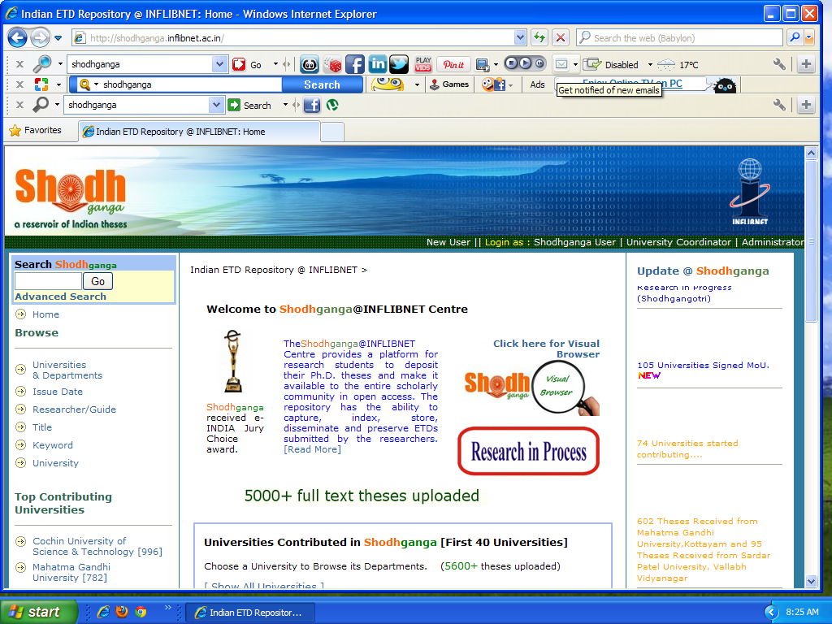

Slide 60
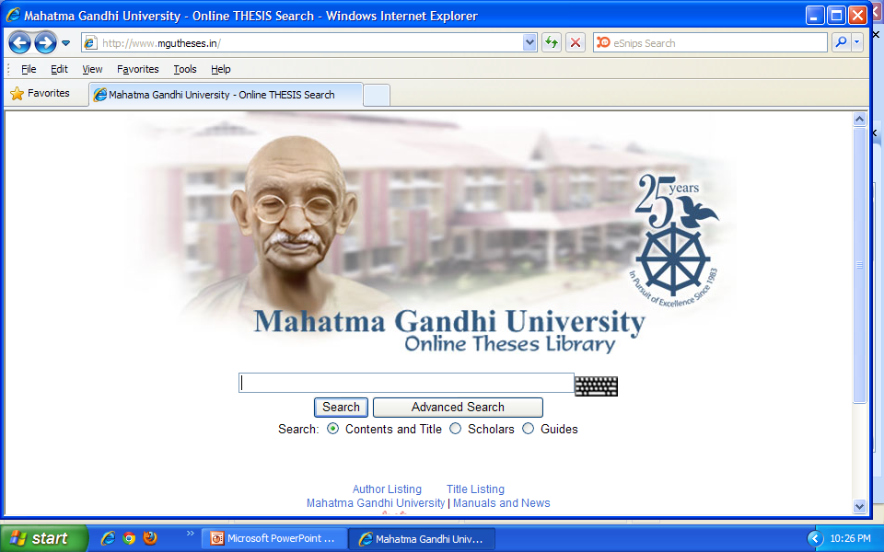
E-theses of M G University

Slide 61
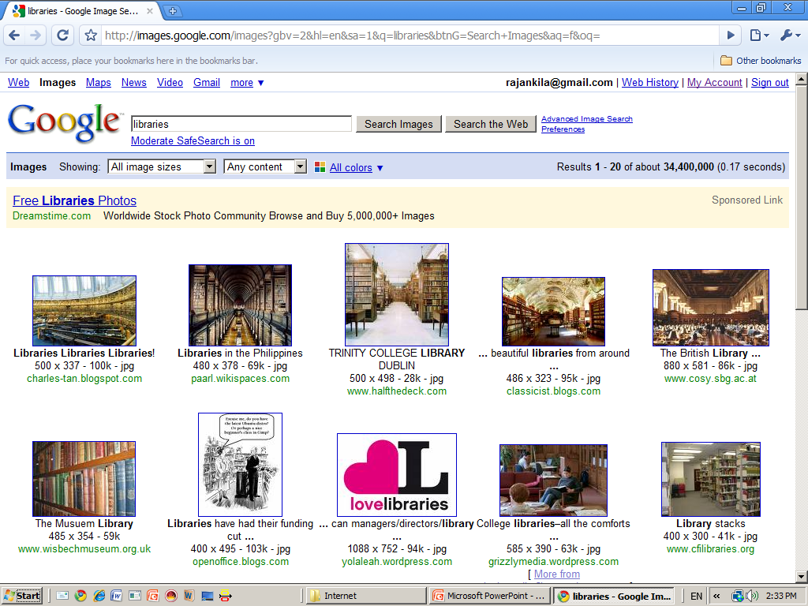

Slide 62
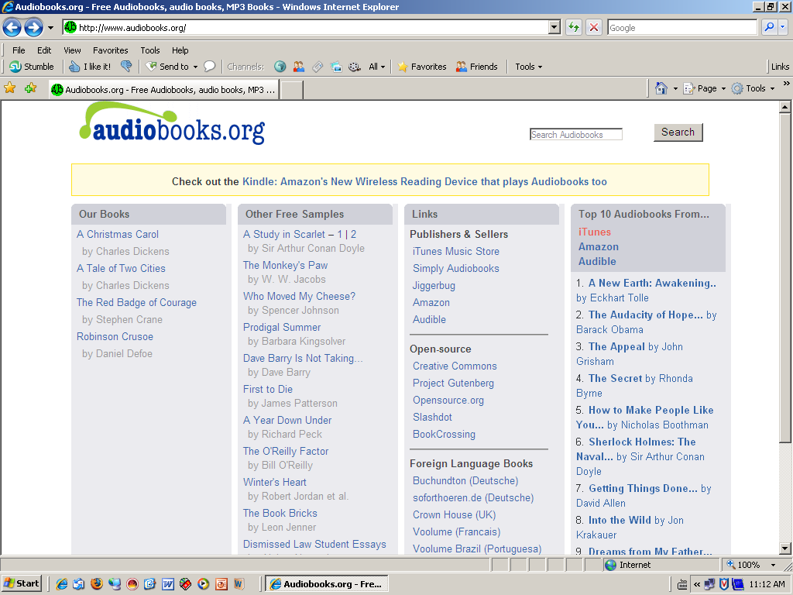
Audiobooks.org – Free

Slide 63
NPTEL
Curriculum based video and web courses for engineering by seven IITs and IISc .
In the first phase, content for 129 web courses in Engineering developed.
Each course contains 40 or more lecture hours.
In addition, 110 courses have been developed in video format, with each course comprising of approximately 40 or more one-hour lectures.
Total cost for the video/web course is Rs. one lakh each.

Slide 64
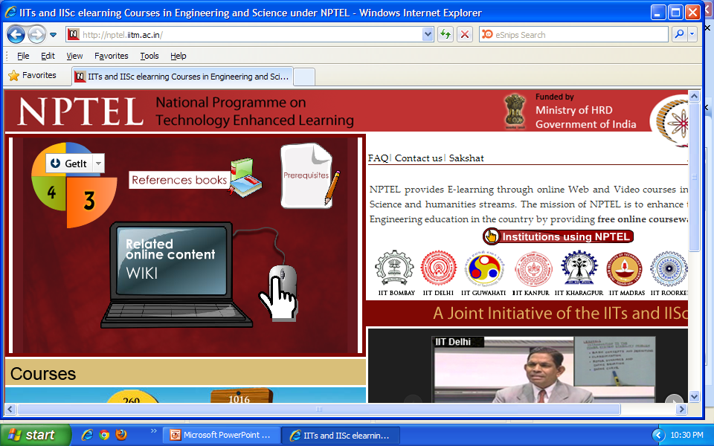

Slide 65
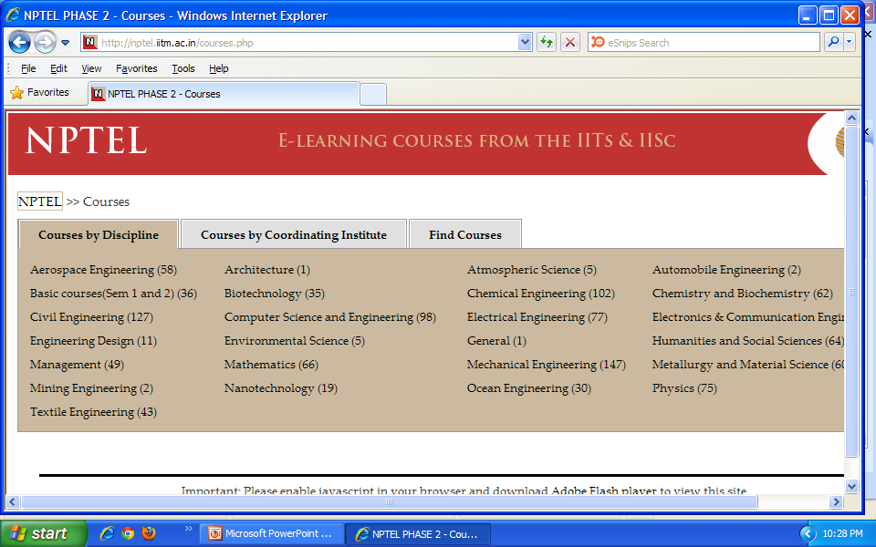

Slide 66
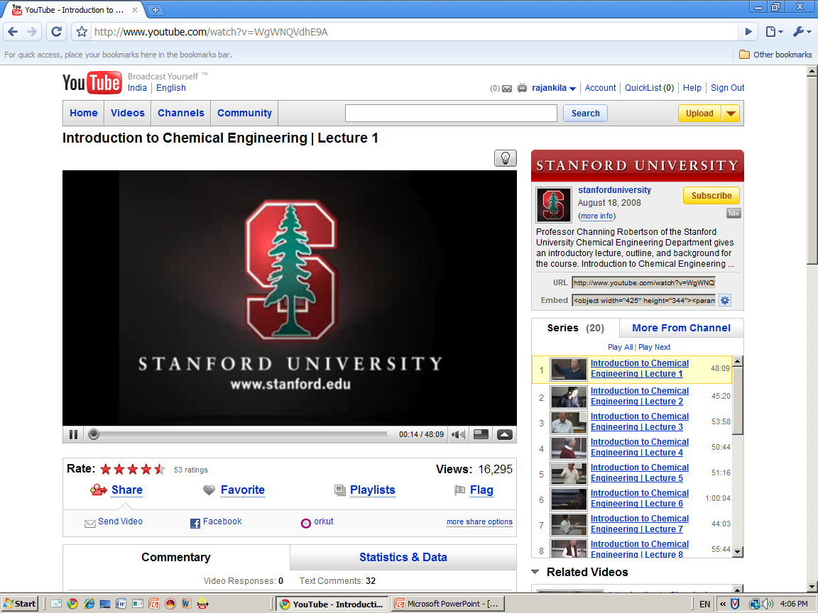
Stanford University Courseware

Slide 67
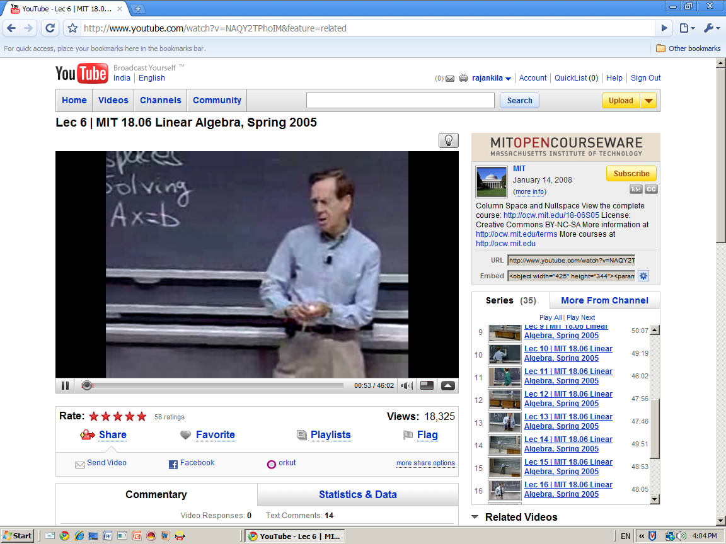
MIT Courseware

Slide 68
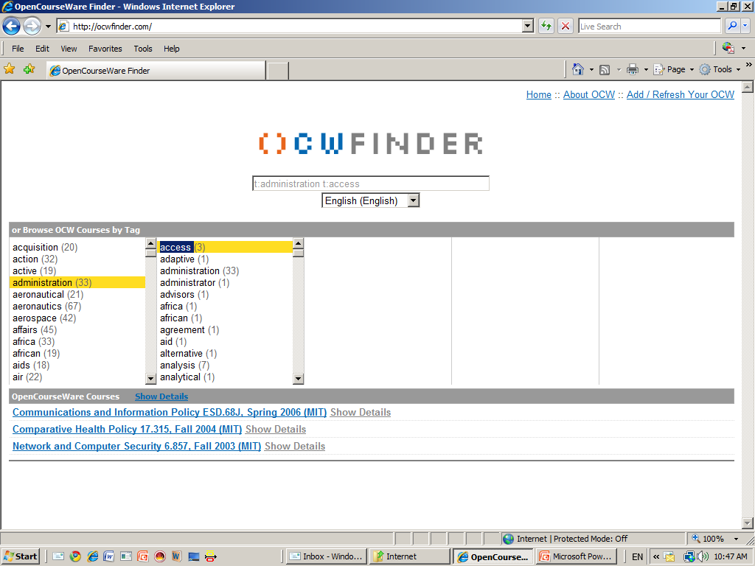
Open courseware finder http://ocwfinder.com/

Slide 69
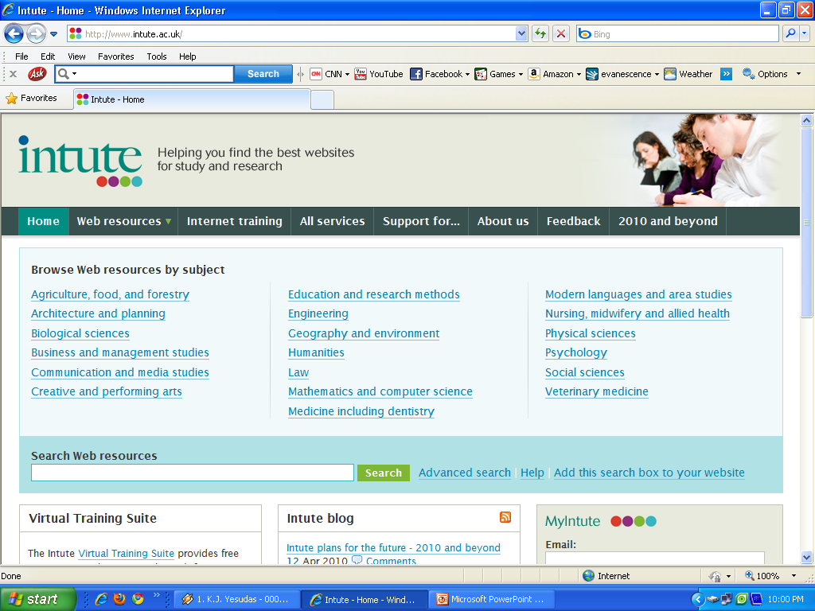

Slide 70
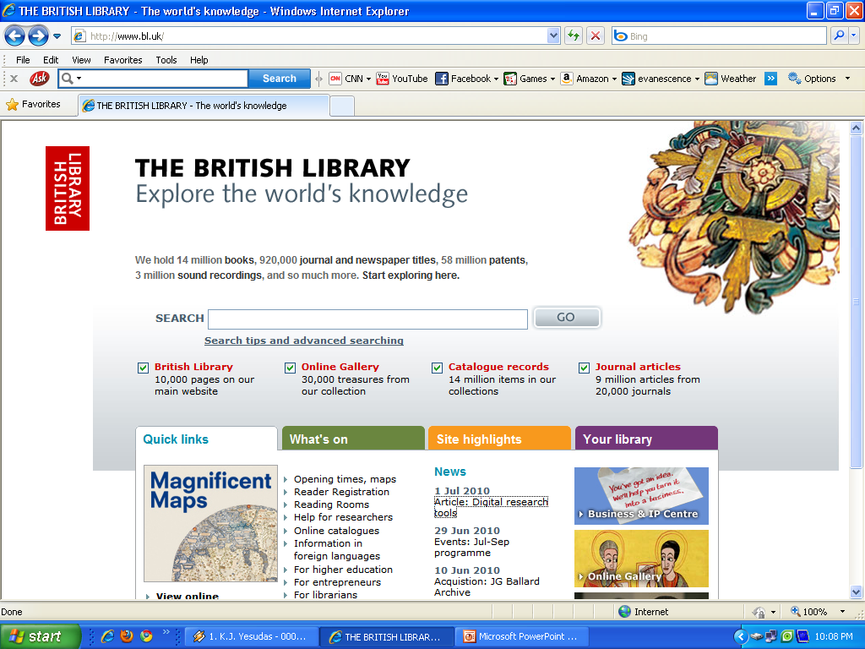

Slide 71
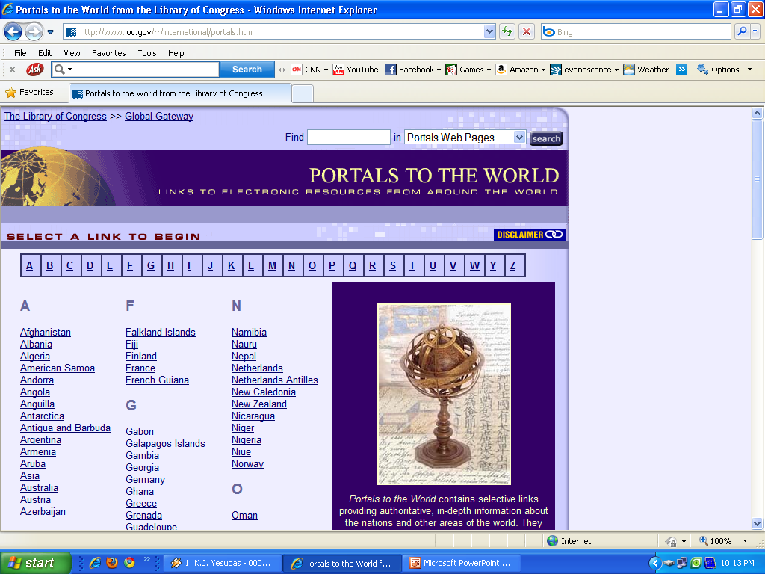

Slide 72
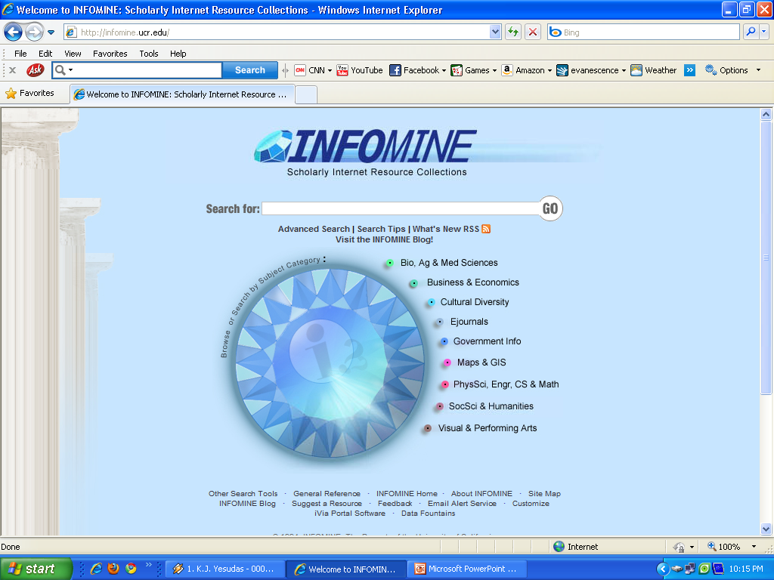

Slide 73
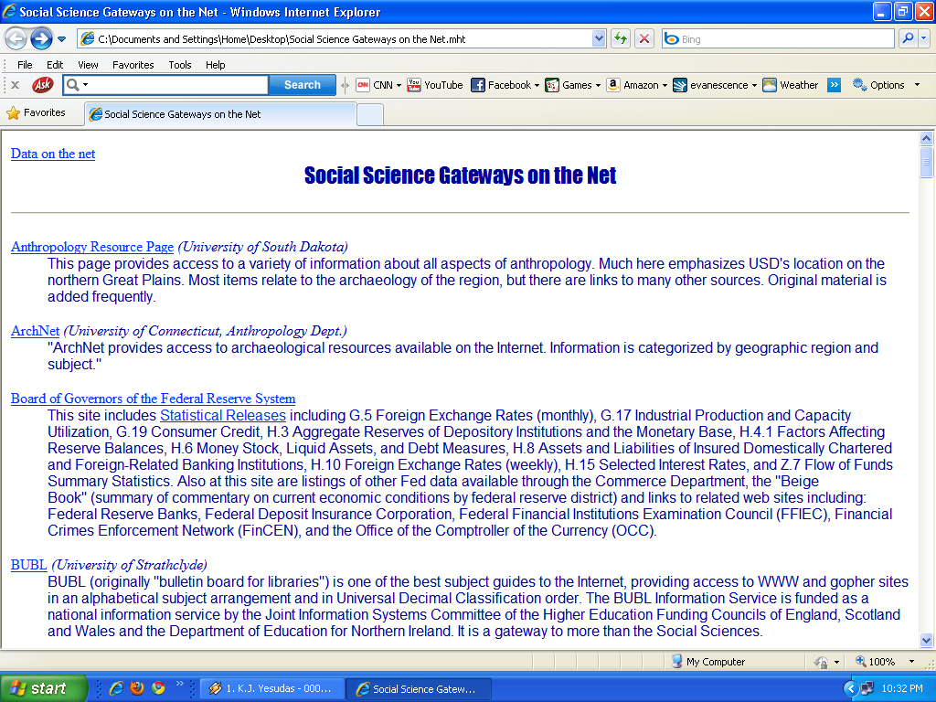

Slide 74
Social Science Research Network (SSRN)
Social Science Research Network (SSRN) is devoted to the rapid worldwide dissemination of social science research and is composed of a number of specialized research networks in each of the social sciences.
Each of SSRN's networks encourages the early distribution of research results by publishing submitted abstracts and by soliciting abstracts of top quality research papers around the world.
It covers hundreds of journals, publishers, and institutions in Partners in Publishing that provide working papers for distribution through SSRN’s eLibrary and abstracts for publication in SSRN's electronic journals.

Slide 75
Social Science Research Network (SSRN)…
The eLibrary also includes the research papers of a number of Fee Based Partner Publications.
The Networks encourage readers to communicate directly with authors and other subscribers concerning their own and others' research.
To facilitate this they publish detailed author contact information including email addresses for authors of each paper.
They also provide electronic delivery of the papers when authors wish us to do so from the SSRN eLibrary.

Slide 76
References
1. American Library Association. Presidential Committee on Information Literacy. Final Report. Chicago: American Library Association, 1989.
2. National Research Council. Commission on Physical Sciences, Mathematics, and Applications. Committee on Information Technology Literacy, Computer Science and Telecommunications Board. Being Fluent with Information Technology. Publication. Washington, D.C.: National Academy Press, 1999. http://www.nap.edu/catalog/6482.html
3. Asher, Curt. Separate but equal: librarians, academics and information literacy. Australian Academic and Research Libraries 34(1) March 2003.
4. Nimon, Maureen. The role of academic libraries in the development of the information literate student: the interface between librarian, academic and other stakeholders. Australian Academic and Research Libraries 32 (1) May 2001.

Slide 77
References
5. Godwin, P. and Parker, J. Information literacy beyond library 2.0. London: Facet Publishing, 2012.
6. Kaplowitz, J.R. Transforming information literacy instruction using learner-centered teaching, London: Facet, 2012
7. Flashpohler, M.R. Engaging first year students in meaningful library research: a practical guide for teaching faculty. Oxford: Chandos Publishing, 2012.
8. Wlash, J. Information literacy instruction: selecting an effective model Oxford: Chandos Publishing, 2011.
9. MacMillan, K. and Kirker, C. Kindergarten magic: theme-based lessons for building literacy and library skills. Chicago: American Library Association, 2012.

Slide 78
Thank You

